Slide 1
Clipping
Cyrus-Beck Algo

Slide 2


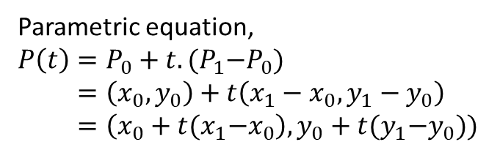

Parametric equation of Line
$$P_{1}(x_{1},y_{1})$$
Parametric equation,
$$P\left(t\right)=P_{0}+t.{(P}_{1}−P_{0}) \\ =\left(x_{0},y_{0}\right)+t\left(x_{1}−x_{0},y_{1}−y_{0}\right) \\ =\left(x_{0}+t{(x}_{1}−x_{0}\right),y_{0}+t{(y}_{1}−y_{0}))$$
$$P(t)$$
$$P_{0}(x_{0},y_{0})$$

Slide 3

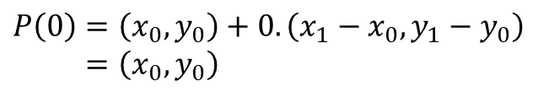
Parametric equation of Line
$$P_{1}(x_{1},y_{1})$$
Parametric equation,
$$P\left(t\right)=P_{0}+t.{(P}_{1}−P_{0}) \\ =\left(x_{0},y_{0}\right)+t\left(x_{1}−x_{0},y_{1}−y_{0}\right) \\ =\left(x_{0}+t{(x}_{1}−x_{0}\right),y_{0}+t{(y}_{1}−y_{0}))$$
$$P(t)$$
$$P\left(0\right)=\left(x_{0},y_{0}\right)+0.\left(x_{1}−x_{0},y_{1}−y_{0}\right) \\ =\left(x_{0},y_{0}\right)$$
$$P(0)$$
$$P_{0}(x_{0},y_{0})$$

Slide 4

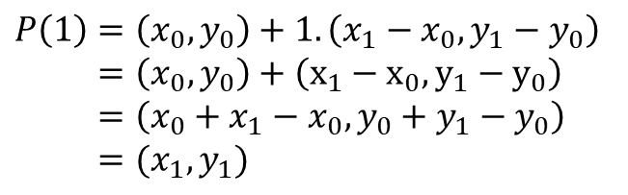
Parametric equation of Line
$$P(1)$$
$$P_{1}(x_{1},y_{1})$$
Parametric equation,
$$P\left(t\right)=P_{0}+t.{(P}_{1}−P_{0}) \\ =\left(x_{0},y_{0}\right)+t\left(x_{1}−x_{0},y_{1}−y_{0}\right) \\ =\left(x_{0}+t{(x}_{1}−x_{0}\right),y_{0}+t{(y}_{1}−y_{0}))$$
$$P(t)$$
$$P\left(1\right)=\left(x_{0},y_{0}\right)+1.\left(x_{1}−x_{0},y_{1}−y_{0}\right) \\ =\left(x_{0},y_{0}\right)+\left(x_{1}−x_{0}, y_{1}−y_{0}\right) \\ =\left(x_{0}+x_{1}−x_{0}, y_{0}+y_{1}−y_{0}\right) \\ =(x_{1},y_{1})$$
$$P_{0}(x_{0},y_{0})$$

Slide 5
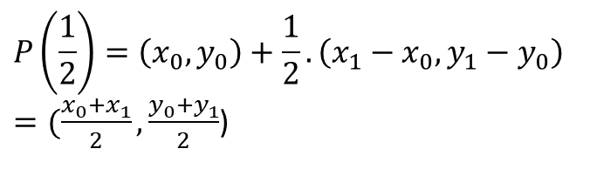

Parametric equation of Line
$$P_{1}(x_{1},y_{1})$$
Parametric equation,
$$P\left(t\right)=P_{0}+t.{(P}_{1}−P_{0}) \\ =\left(x_{0},y_{0}\right)+t\left(x_{1}−x_{0},y_{1}−y_{0}\right) \\ =\left(x_{0}+t{(x}_{1}−x_{0}\right),y_{0}+t{(y}_{1}−y_{0}))$$
$$P(\frac{1}{2})$$
$$P\left(\frac{1}{2}\right)=\left(x_{0},y_{0}\right)+\frac{1}{2}.\left(x_{1}−x_{0},y_{1}−y_{0}\right)$$ $=(\frac{x_{0}+x_{1}}{2}, \frac{y_{0}+y_{1}}{2}$)
$$P_{0}(x_{0},y_{0})$$

Slide 6


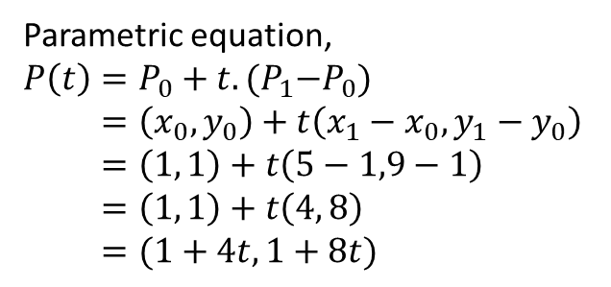
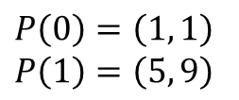

Parametric equation of Line
Suppose, endpoints of a line are (1, 1) and (5, 9)
$$P_{1}(5,9)$$
Parametric equation,
$$P\left(t\right)=P_{0}+t.{(P}_{1}−P_{0}) \\ =\left(x_{0},y_{0}\right)+t\left(x_{1}−x_{0},y_{1}−y_{0}\right) \\ =\left(1, 1\right)+t\left(5−1,9−1\right) \\ =\left(1, 1\right)+t\left(4, 8\right) \\ =(1+4t, 1+8t)$$
$$P(t)$$
$$P_{0}(1,1)$$
$$P\left(0\right)=\left(1, 1\right) \\ P\left(1\right)=\left(5, 9\right)$$

Slide 7


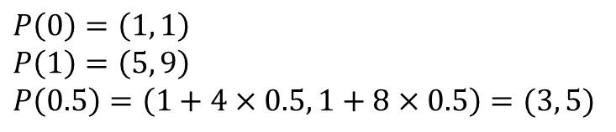

Parametric equation of Line
$$P(1)$$
Suppose, endpoints of a line are (1, 1) and (5, 9)
$$P_{1}(5,9)$$
Parametric equation,
$$P\left(t\right)=P_{0}+t.{(P}_{1}−P_{0}) \\ =\left(x_{0},y_{0}\right)+t\left(x_{1}−x_{0},y_{1}−y_{0}\right) \\ =\left(1, 1\right)+t\left(5−1,9−1\right) \\ =\left(1, 1\right)+t\left(4, 8\right) \\ =(1+4t, 1+8t)$$
$$P(0.5)$$
$$P(0)$$
$$P_{0}(1,1)$$
$$P\left(0\right)=\left(1, 1\right) \\ P\left(1\right)=\left(5, 9\right) \\ P\left(0.5\right)=\left(1+4×0.5, 1+8×0.5\right)=(3, 5)$$

Slide 8

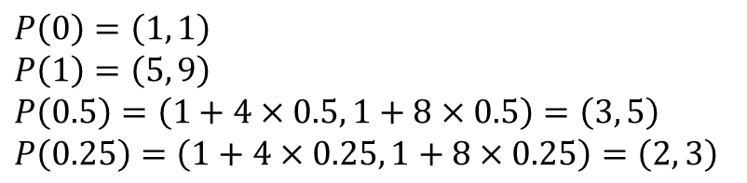


Parametric equation of Line
$$P(1)$$
Suppose, endpoints of a line are (1, 1) and (5, 9)
$$P_{1}(5,9)$$
Parametric equation,
$$P\left(t\right)=P_{0}+t.{(P}_{1}−P_{0}) \\ =\left(x_{0},y_{0}\right)+t\left(x_{1}−x_{0},y_{1}−y_{0}\right) \\ =\left(1, 1\right)+t\left(5−1,9−1\right) \\ =\left(1, 1\right)+t\left(4, 8\right) \\ =(1+4t, 1+8t)$$
$$P(0.5)$$
$$P(0.25)$$
$$(3,5)$$
$$P(0)$$
$$(2,3)$$
$$P_{0}(1,1)$$
$$P\left(0\right)=\left(1, 1\right) \\ P\left(1\right)=\left(5, 9\right) \\ P\left(0.5\right)=\left(1+4×0.5, 1+8×0.5\right)=\left(3, 5\right) \\ P\left(0.25\right)=\left(1+4×0.25, 1+8×0.25\right)=\left(2, 3\right)$$

Slide 9
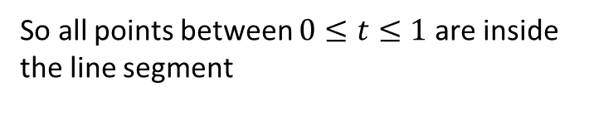
Parametric equation of Line
$$P(1)$$
Suppose, endpoints of a line are (1, 1) and (5, 9)
$$P_{1}(5,9)$$
Parametric equation,
$$P\left(t\right)=P_{0}+t.{(P}_{1}−P_{0}) \\ =\left(x_{0},y_{0}\right)+t\left(x_{1}−x_{0},y_{1}−y_{0}\right) \\ =\left(1, 1\right)+t\left(5−1,9−1\right) \\ =\left(1, 1\right)+t\left(4, 8\right) \\ =(1+4t, 1+8t)$$
$$P(0.5)$$
$$P(0.25)$$
$$(3,5)$$
$$P(0)$$
$$(2,3)$$
$$P_{0}(1,1)$$
So all points between $0≤t≤1$are inside the line segment

Slide 10



Parametric equation of Line
$$P(1.3)$$
$$P(1)$$
Suppose, endpoints of a line are (1, 1) and (5, 9)
$$P_{1}(5,9)$$
Parametric equation,
$$P\left(t\right)=P_{0}+t.{(P}_{1}−P_{0}) \\ =\left(x_{0},y_{0}\right)+t\left(x_{1}−x_{0},y_{1}−y_{0}\right) \\ =\left(1, 1\right)+t\left(5−1,9−1\right) \\ =\left(1, 1\right)+t\left(4, 8\right) \\ =(1+4t, 1+8t)$$
$$P(0.5)$$
$$P(0.25)$$
$$(3,5)$$
$$P(0)$$
$$(2,3)$$
$$P(−0.3)$$
$$P_{0}(1,1)$$
P(-0.3) and P(1.3) are outside the line segment

Slide 11
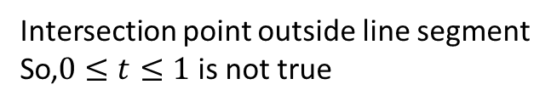
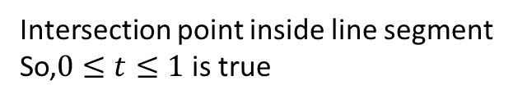
boundary
boundary
Intersection point inside line segment
So,$0≤t≤1$ is true
Intersection point outside line segment
So,$0≤t≤1$ is not true

Slide 12




P₁
$$t_{right}=0.8$$
Window
y_{max}
$$t_{top}=0.6$$
Both endpoints outside
All intersections have t between 0 and 1
$$t_{left}=0.3$$
y_{min}
$$t_{bottom}=0.2$$
P₀
x_{min}
x_{max}

Slide 13




$$t_{right}=2.8$$
Window
y_{max}
$$t_{top}=1.2$$
P₁
Both endpoints inside
All intersections have t outside 0 to 1
P₀
$$t_{left}=−0.4$$
y_{min}
$$t_{bottom}=−1.2$$
x_{min}
x_{max}

Slide 14
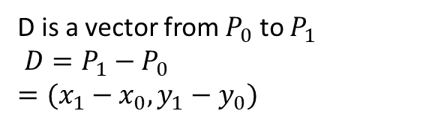
Vector
D is a vector from $P_{0}$ to $P_{1}$
$D=P_{1}−P_{0}$ $$=(x_{1}−x_{0},y_{1}−y_{0})$$
P₁
D
P₀

Slide 15
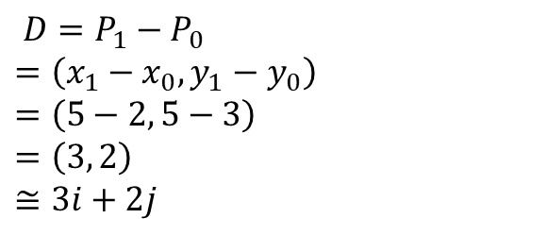
Vector
$D=P_{1}−P_{0}$ $$=\left(x_{1}−x_{0},y_{1}−y_{0}\right) \\ =\left(5−2, 5−3\right) \\ =\left(3, 2\right) \\ ≅3i+2j$$
P₁ (5,5)
D
P₀ (2,3)

Slide 16


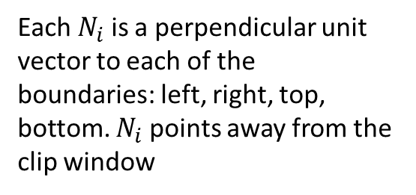


Normal vectors to boundary
$$N_{top}=(0, 1)$$
Each $N_{i}$ is a perpendicular unit vector to each of the boundaries: left, right, top, bottom. $N_{i}$ points away from the clip window
$$N_{left}=(−1, 0)$$
$$N_{right}=(1, 0)$$
$$N_{bottom}=(0, −1)$$

Slide 17


Normal vectors to boundary
D = P₁ -P₀
P₁
When angle between N_{i} and D is more than 90 degree-
Or, N_{i} . D < 0
The intersection point is PE
(Potentially entering)
$$N_{top}=(0, 1)$$
$$N_{right}=(1, 0)$$
PL
$$N_{left}=(−1, 0)$$
PE
When angle between N_{i} and D is less than 90 degree-
Or, N_{i} . D > 0
The intersection point is PL
(Potentially leaving)
P₀
$$N_{bottom}=(0, −1)$$

Slide 18
PE = Potentially Entering
PL = Potentially Leaving

Slide 19
Cyrus-Beck algo
Calculate t values of intersection points with each 4 boundaries
Classify intersection points whether PE/PL
Select the PE with highest t and the PL with the lowest t
Using parametric line eqn. find the clipped points

Slide 20
The Cyrus-Beck Algorithm

Slide 21
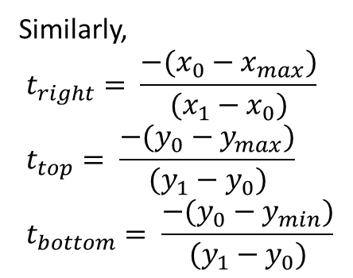
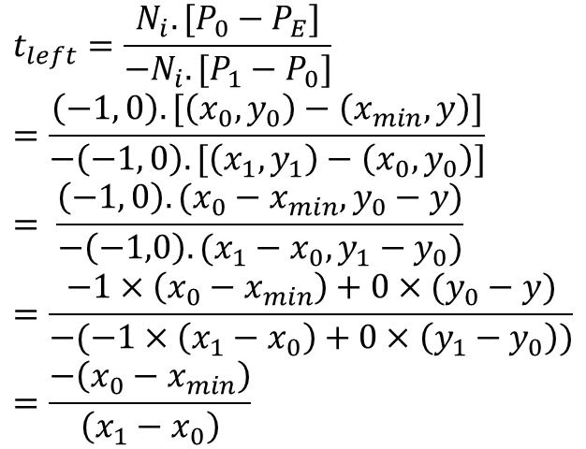
The Cyrus-Beck Algorithm
For left boundary,
Similarly,
$$t_{right}= \frac{−(x_{0}−x_{max})}{(x_{1}−x_{0})} \\ t_{top}= \frac{−(y_{0}−y_{max})}{(y_{1}−y_{0})} \\ t_{bottom}= \frac{−(y_{0}−y_{min})}{(y_{1}−y_{0})}$$
$$t_{left}=\frac{N_{i}.[P_{0}−P_{E}]}{−N_{i}.[P_{1}−P_{0}]} \\ =\frac{\left(−1, 0\right). [\left(x_{0}, y_{0}\right)−\left(x_{min}, y\right)]}{−\left(−1, 0\right).[\left(x_{1},y_{1}\right)−\left(x_{0},y_{0}\right)]} \\ = \frac{\left(−1, 0\right). (x_{0}−x_{min}, y_{0}−y)}{−\left(−1,0\right).(x_{1}−x_{0},y_{1}−y_{0})} \\ =\frac{−1×\left(x_{0}−x_{min}\right)+0×(y_{0}−y)}{−(−1×\left(x_{1}−x_{0}\right)+0×\left(y_{1}−y_{0}\right))} \\ =\frac{−\left(x_{0}−x_{min}\right)}{\left(x_{1}−x_{0}\right)}$$

Slide 22
The Cyrus-Beck Algorithm
Precalculate N_{i} and P_{Ei} for each edge
for (each line segment to be clipped) {
if (P₁ == P₀)
line is degenerated, so clip as a point;
else {
t_{E} = 0; t_{L} = 1;
for (each candidate intersection with a clip edge) {
if (N_{i} • D != 0) { /* Ignore edges parallel to line */
calculate t;
use sign of N_{i} • D to categorize as PE or PL;
if (PE) t_{E} = max(t_{E} , t);
if (PL) t_{L} = min(t_{L} , t); }
}
if (t_{E} > t_{L}) return NULL;
else return P(t_{E}) and P(t_{L}) as true clip intersection;
}
}

Slide 23
a) Calculate the value of t of the lines given below for all edges and specify whether they are entering or leaving t. [Given (0,0) to (300,200) be the clip region.]
(i) (50, -125) to (-100, 225).
(ii) (-250, 200) to (250, -200).
(iii) (-250, 200) to (150, 100)
Also, find the line segment within the clipping window

Slide 24
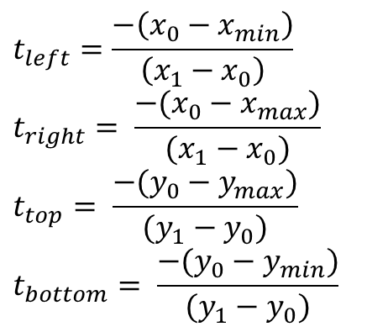
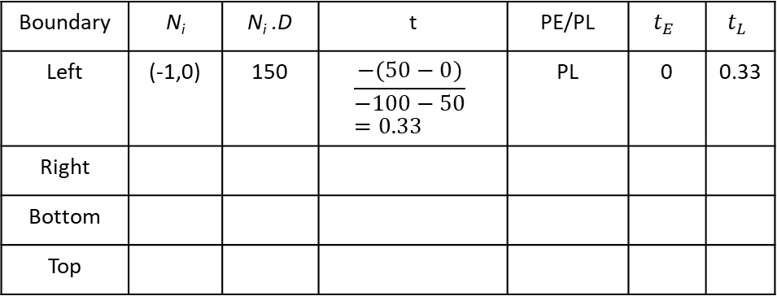

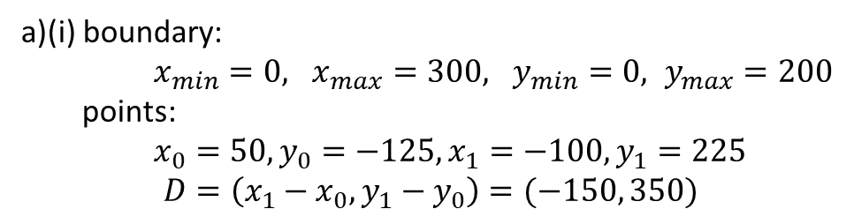
$$t_{left}=\frac{−\left(x_{0}−x_{min}\right)}{\left(x_{1}−x_{0}\right)}$$
$$t_{right}= \frac{−(x_{0}−x_{max})}{(x_{1}−x_{0})} \\ t_{top}= \frac{−(y_{0}−y_{max})}{(y_{1}−y_{0})} \\ t_{bottom}= \frac{−(y_{0}−y_{min})}{(y_{1}−y_{0})}$$
a)(i) boundary:
$x_{min}=0, x_{max}=300, y_{min}=0, y_{max}=200$
points:
$x_{0}=50, y_{0}=−125, x_{1}=−100, y_{1}=225$ $$D=\left(x_{1}−x_{0}, y_{1}−y_{0}\right)=(−150, 350)$$
Initially, $t_{E}=0, t_{L}=1$
Boundary | N_{i} | N_{i} .D | t | PE/PL | $$t_{E}$$ | $$t_{L}$$
Left | (-1,0) | 150 | $$\frac{−(50−0)}{−100−50} \\ =0.33$$ | PL | 0 | 0.33
Right
Bottom
Top
Algorithm
Precalculate N_{i} and P_{Ei} for each edge
for (each line segment to be clipped) {
if (P₁ == P₀)
line is degenerated, so clip as a point;
else {
t_{E} = 0; t_{L} = 1;
for (each candidate intersection with a clip edge) {
if (N_{i} • D != 0) { /* Ignore edges parallel to line */
calculate t;
use sign of N_{i} • D to categorize as PE or PL;
if (PE) t_{E} = max(t_{E} , t);
if (PL) t_{L} = min(t_{L} , t); }
}
if (t_{E} > t_{L}) return NULL;
else return P(t_{E}) and P(t_{L}) as true clip intersection;
}
}

Slide 25
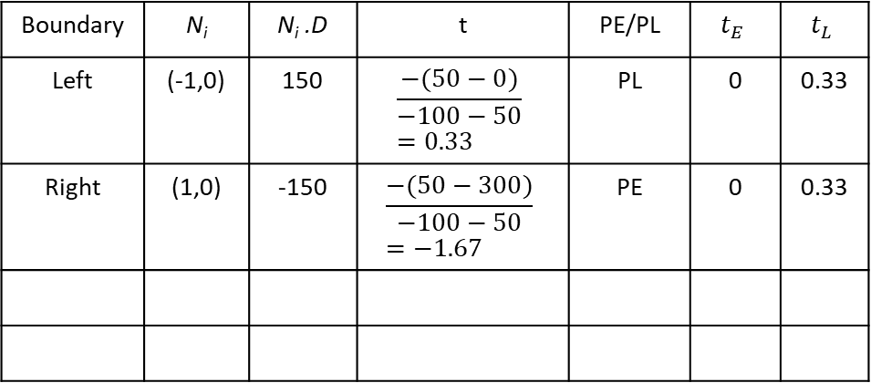
$$t_{left}=\frac{−\left(x_{0}−x_{min}\right)}{\left(x_{1}−x_{0}\right)}$$
$$t_{right}= \frac{−(x_{0}−x_{max})}{(x_{1}−x_{0})} \\ t_{top}= \frac{−(y_{0}−y_{max})}{(y_{1}−y_{0})} \\ t_{bottom}= \frac{−(y_{0}−y_{min})}{(y_{1}−y_{0})}$$
a)(i) boundary:
$x_{min}=0, x_{max}=300, y_{min}=0, y_{max}=200$
points:
$x_{0}=50, y_{0}=−125, x_{1}=−100, y_{1}=225$ $$D=\left(x_{1}−x_{0}, y_{1}−y_{0}\right)=(−150, 350)$$
Initially, $t_{E}=0, t_{L}=1$
Boundary | N_{i} | N_{i} .D | t | PE/PL | $$t_{E}$$ | $$t_{L}$$
Left | (-1,0) | 150 | $$\frac{−(50−0)}{−100−50} \\ =0.33$$ | PL | 0 | 0.33
Right | (1,0) | -150 | $$\frac{−(50−300)}{−100−50} \\ =−1.67$$ | PE | 0 | 0.33
Algorithm
Precalculate N_{i} and P_{Ei} for each edge
for (each line segment to be clipped) {
if (P₁ == P₀)
line is degenerated, so clip as a point;
else {
t_{E} = 0; t_{L} = 1;
for (each candidate intersection with a clip edge) {
if (N_{i} • D != 0) { /* Ignore edges parallel to line */
calculate t;
use sign of N_{i} • D to categorize as PE or PL;
if (PE) t_{E} = max(t_{E} , t);
if (PL) t_{L} = min(t_{L} , t); }
}
if (t_{E} > t_{L}) return NULL;
else return P(t_{E}) and P(t_{L}) as true clip intersection;
}
}

Slide 26
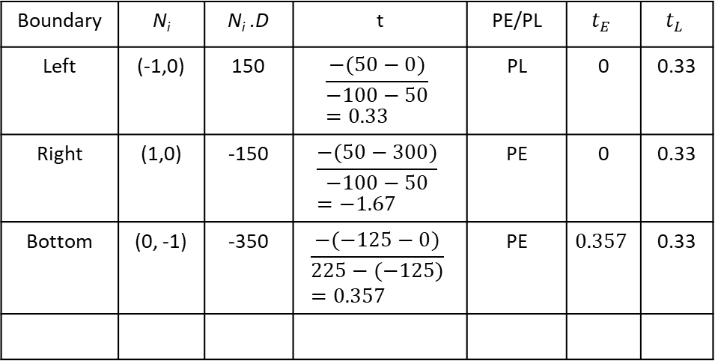
$$t_{left}=\frac{−\left(x_{0}−x_{min}\right)}{\left(x_{1}−x_{0}\right)}$$
$$t_{right}= \frac{−(x_{0}−x_{max})}{(x_{1}−x_{0})} \\ t_{top}= \frac{−(y_{0}−y_{max})}{(y_{1}−y_{0})} \\ t_{bottom}= \frac{−(y_{0}−y_{min})}{(y_{1}−y_{0})}$$
a)(i) boundary:
$x_{min}=0, x_{max}=300, y_{min}=0, y_{max}=200$
points:
$x_{0}=50, y_{0}=−125, x_{1}=−100, y_{1}=225$ $$D=\left(x_{1}−x_{0}, y_{1}−y_{0}\right)=(−150, 350)$$
Initially, $t_{E}=0, t_{L}=1$
Boundary | N_{i} | N_{i} .D | t | PE/PL | $$t_{E}$$ | $$t_{L}$$
Left | (-1,0) | 150 | $$\frac{−(50−0)}{−100−50} \\ =0.33$$ | PL | 0 | 0.33
Right | (1,0) | -150 | $$\frac{−(50−300)}{−100−50} \\ =−1.67$$ | PE | 0 | 0.33
Bottom | (0, -1) | -350 | $$\frac{−(−125−0)}{225−(−125)} \\ =0.357$$ | PE | $$0.357$$ | 0.33
Algorithm
Precalculate N_{i} and P_{Ei} for each edge
for (each line segment to be clipped) {
if (P₁ == P₀)
line is degenerated, so clip as a point;
else {
t_{E} = 0; t_{L} = 1;
for (each candidate intersection with a clip edge) {
if (N_{i} • D != 0) { /* Ignore edges parallel to line */
calculate t;
use sign of N_{i} • D to categorize as PE or PL;
if (PE) t_{E} = max(t_{E} , t);
if (PL) t_{L} = min(t_{L} , t); }
}
if (t_{E} > t_{L}) return NULL;
else return P(t_{E}) and P(t_{L}) as true clip intersection;
}
}

Slide 27
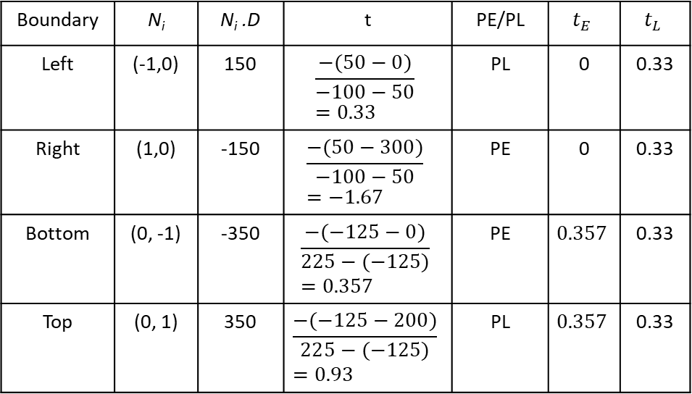
$$t_{left}=\frac{−\left(x_{0}−x_{min}\right)}{\left(x_{1}−x_{0}\right)}$$
$$t_{right}= \frac{−(x_{0}−x_{max})}{(x_{1}−x_{0})} \\ t_{top}= \frac{−(y_{0}−y_{max})}{(y_{1}−y_{0})} \\ t_{bottom}= \frac{−(y_{0}−y_{min})}{(y_{1}−y_{0})}$$
a)(i) boundary:
$x_{min}=0, x_{max}=300, y_{min}=0, y_{max}=200$
points:
$x_{0}=50, y_{0}=−125, x_{1}=−100, y_{1}=225$ $$D=\left(x_{1}−x_{0}, y_{1}−y_{0}\right)=(−150, 350)$$
Initially, $t_{E}=0, t_{L}=1$
Boundary | N_{i} | N_{i} .D | t | PE/PL | $$t_{E}$$ | $$t_{L}$$
Left | (-1,0) | 150 | $$\frac{−(50−0)}{−100−50} \\ =0.33$$ | PL | 0 | 0.33
Right | (1,0) | -150 | $$\frac{−(50−300)}{−100−50} \\ =−1.67$$ | PE | 0 | 0.33
Bottom | (0, -1) | -350 | $$\frac{−(−125−0)}{225−(−125)} \\ =0.357$$ | PE | $$0.357$$ | 0.33
Top | (0, 1) | 350 | $$\frac{−(−125−200)}{225−(−125)} \\ =0.93$$ | PL | $$0.357$$ | 0.33
Algorithm
Precalculate N_{i} and P_{Ei} for each edge
for (each line segment to be clipped) {
if (P₁ == P₀)
line is degenerated, so clip as a point;
else {
t_{E} = 0; t_{L} = 1;
for (each candidate intersection with a clip edge) {
if (N_{i} • D != 0) { /* Ignore edges parallel to line */
calculate t;
use sign of N_{i} • D to categorize as PE or PL;
if (PE) t_{E} = max(t_{E} , t);
if (PL) t_{L} = min(t_{L} , t); }
}
if (t_{E} > t_{L}) return NULL;
else return P(t_{E}) and P(t_{L}) as true clip intersection;
}
}
Since t_{E} > t_{L} , line segment is outside clip window

Slide 28
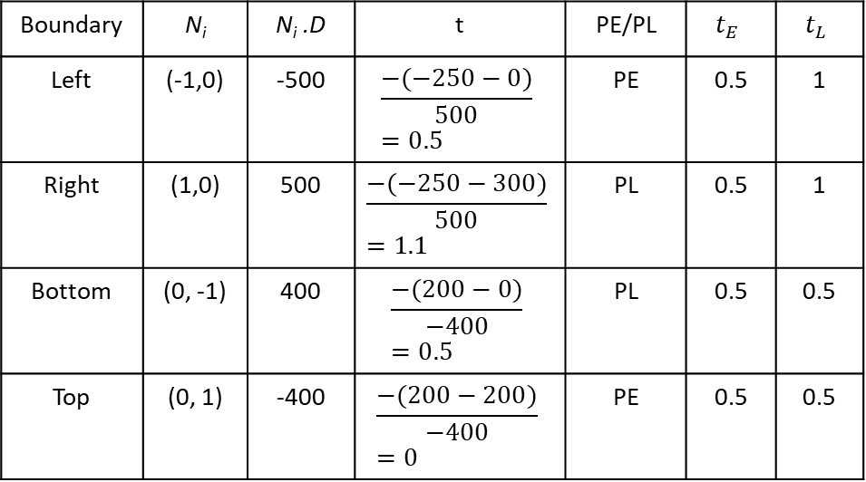
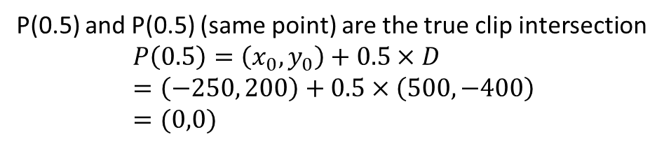

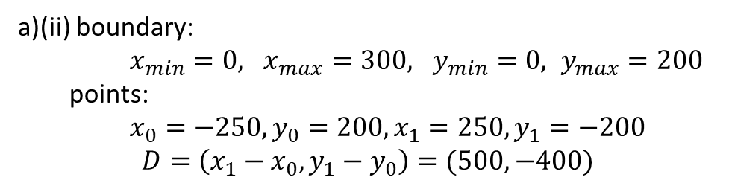
$$t_{left}=\frac{−\left(x_{0}−x_{min}\right)}{\left(x_{1}−x_{0}\right)}$$
$$t_{right}= \frac{−(x_{0}−x_{max})}{(x_{1}−x_{0})} \\ t_{top}= \frac{−(y_{0}−y_{max})}{(y_{1}−y_{0})} \\ t_{bottom}= \frac{−(y_{0}−y_{min})}{(y_{1}−y_{0})}$$
a)(ii) boundary:
$x_{min}=0, x_{max}=300, y_{min}=0, y_{max}=200$
points:
$x_{0}=−250, y_{0}=200, x_{1}=250, y_{1}=−200$ $$D=\left(x_{1}−x_{0}, y_{1}−y_{0}\right)=(500, −400)$$
Initially, $t_{E}=0, t_{L}=1$
Boundary | N_{i} | N_{i} .D | t | PE/PL | $$t_{E}$$ | $$t_{L}$$
Left | (-1,0) | -500 | $$\frac{−(−250−0)}{500} \\ =0.5$$ | PE | 0.5 | 1
Right | (1,0) | 500 | $$\frac{−(−250−300)}{500} \\ =1.1$$ | PL | 0.5 | 1
Bottom | (0, -1) | 400 | $$\frac{−(200−0)}{−400} \\ =0.5$$ | PL | 0.5 | 0.5
Top | (0, 1) | -400 | $$\frac{−(200−200)}{−400} \\ =0$$ | PE | 0.5 | 0.5
Algorithm
Precalculate N_{i} and P_{Ei} for each edge
for (each line segment to be clipped) {
if (P₁ == P₀)
line is degenerated, so clip as a point;
else {
t_{E} = 0; t_{L} = 1;
for (each candidate intersection with a clip edge) {
if (N_{i} • D != 0) { /* Ignore edges parallel to line */
calculate t;
use sign of N_{i} • D to categorize as PE or PL;
if (PE) t_{E} = max(t_{E} , t);
if (PL) t_{L} = min(t_{L} , t); }
}
if (t_{E} > t_{L}) return NULL;
else return P(t_{E}) and P(t_{L}) as true clip intersection;
}
}
P(0.5) and P(0.5) (same point) are the true clip intersection
$$P\left(0.5\right)=\left(x_{0},y_{0}\right)+0.5×D \\ =\left(−250, 200\right)+0.5×\left(500,−400\right) \\ =(0,0)$$

Slide 29
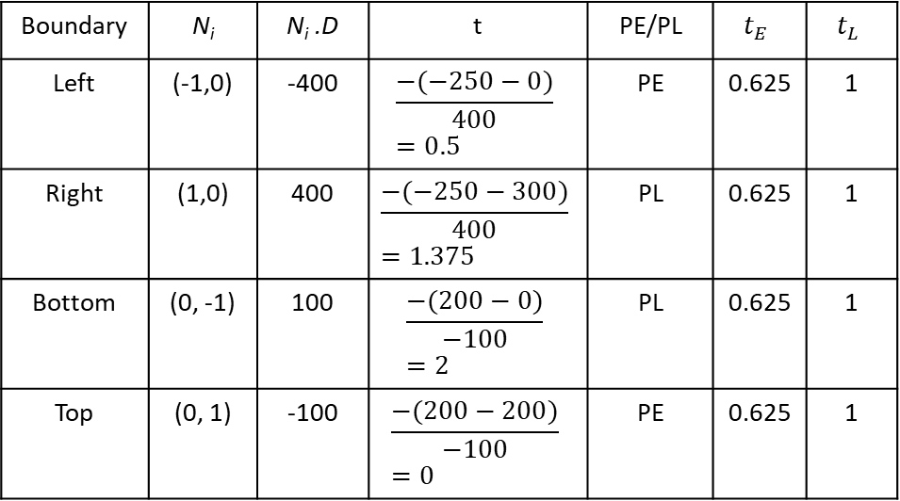
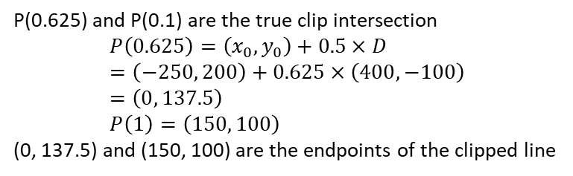

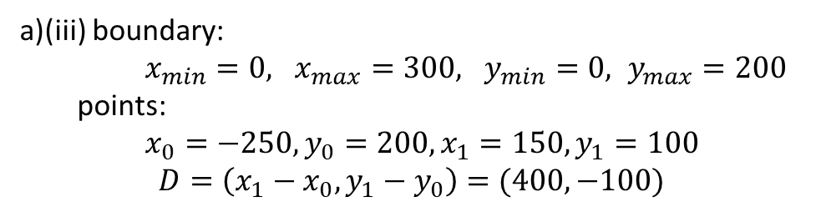
a)(iii) boundary:
$x_{min}=0, x_{max}=300, y_{min}=0, y_{max}=200$
points:
$x_{0}=−250, y_{0}=200, x_{1}=150, y_{1}=100$ $$D=\left(x_{1}−x_{0}, y_{1}−y_{0}\right)=(400, −100)$$
$$t_{left}=\frac{−\left(x_{0}−x_{min}\right)}{\left(x_{1}−x_{0}\right)}$$
$$t_{right}= \frac{−(x_{0}−x_{max})}{(x_{1}−x_{0})} \\ t_{top}= \frac{−(y_{0}−y_{max})}{(y_{1}−y_{0})} \\ t_{bottom}= \frac{−(y_{0}−y_{min})}{(y_{1}−y_{0})}$$
Initially, $t_{E}=0, t_{L}=1$
Boundary | N_{i} | N_{i} .D | t | PE/PL | $$t_{E}$$ | $$t_{L}$$
Left | (-1,0) | -400 | $$\frac{−(−250−0)}{400} \\ =0.5$$ | PE | 0.625 | 1
Right | (1,0) | 400 | $$\frac{−(−250−300)}{400} \\ =1.375$$ | PL | 0.625 | 1
Bottom | (0, -1) | 100 | $$\frac{−(200−0)}{−100} \\ =2$$ | PL | 0.625 | 1
Top | (0, 1) | -100 | $$\frac{−(200−200)}{−100} \\ =0$$ | PE | 0.625 | 1
Algorithm
Precalculate N_{i} and P_{Ei} for each edge
for (each line segment to be clipped) {
if (P₁ == P₀)
line is degenerated, so clip as a point;
else {
t_{E} = 0; t_{L} = 1;
for (each candidate intersection with a clip edge) {
if (N_{i} • D != 0) { /* Ignore edges parallel to line */
calculate t;
use sign of N_{i} • D to categorize as PE or PL;
if (PE) t_{E} = max(t_{E} , t);
if (PL) t_{L} = min(t_{L} , t); }
}
if (t_{E} > t_{L}) return NULL;
else return P(t_{E}) and P(t_{L}) as true clip intersection;
}
}
P(0.625) and P(0.1) are the true clip intersection
$$P\left(0.625\right)=\left(x_{0},y_{0}\right)+0.5×D \\ =\left(−250, 200\right)+0.625×\left(400,−100\right) \\ =\left(0, 137.5\right) \\ P\left(1\right)=\left(150, 100\right)$$
(0, 137.5) and (150, 100) are the endpoints of the clipped line

